Slide 1
Options consultation launch March 2017
A428 Black Cat to Caxton Gibbet improvement scheme

Slide 2
A428 Black Cat to Caxton Gibbet options consultation is launched
Launch: 6 March 2017
Consultation closes: 23 April 2017

Slide 3
What are we trying to achieve?
Known issues on the A428
Congestion
Safety for all road users and workers
Resilience
Junction performance
Enabling economic growth
Provision for non-motorised users
£2 billion invested this Road Period
East of England Road Investment Strategy

Slide 4
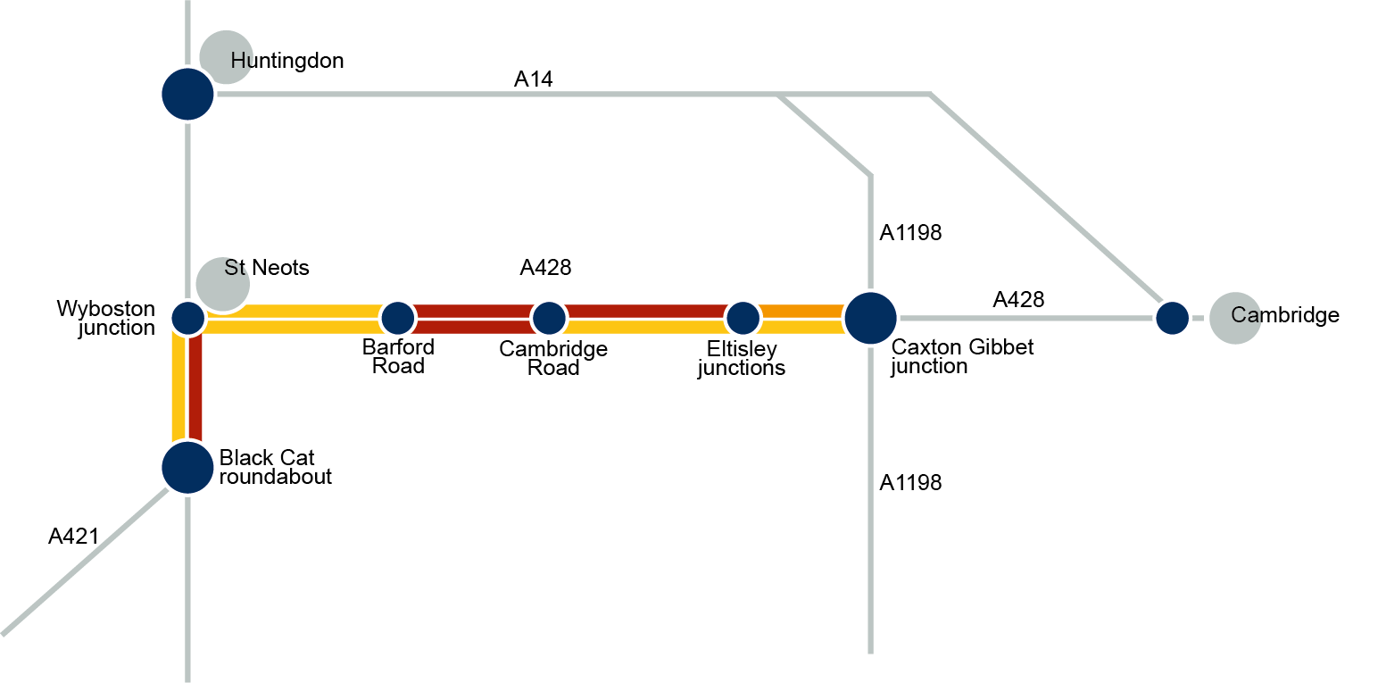
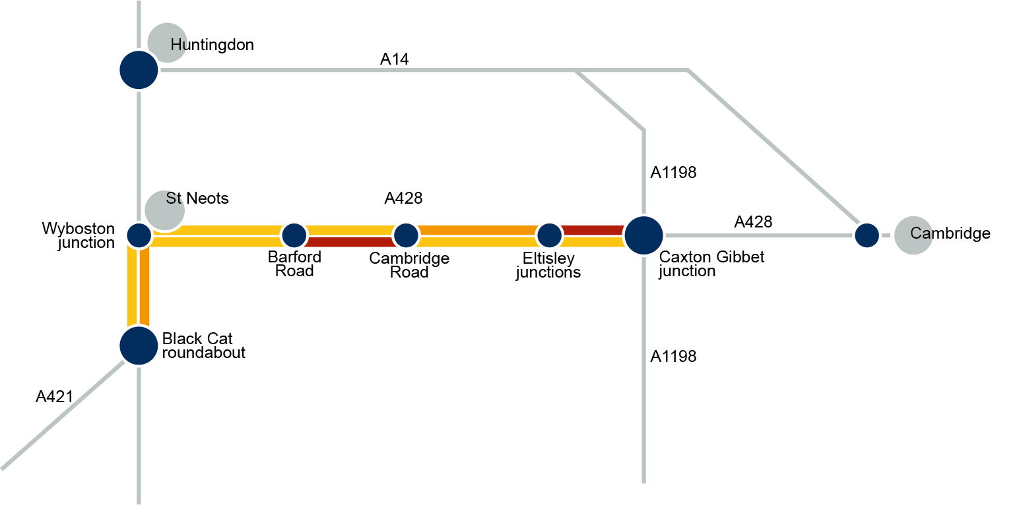
Delays to journey time
Average delays to journey (morning)
Girton interchange
Average delays to journey (evening)
Girton interchange

Slide 5
Our objectives
Support economic growth
A safe and serviceable network
A more free-flowing network
An improved environment
A more accessible and integrated network
Customer satisfaction

Slide 6
Sifting options
Identify issues and define scheme objectives
Create a long list of options to achieve these objectives (40+)
Selection of suitable options for consultation
Options consultation

Slide 7
We are consulting on
Route options
All options propose a new dual carriageway between Black Cat and Caxton Gibbet, situated away from the current alignment of the A428. All options will also improve the roundabouts at Black Cat and Caxton Gibbet.

Slide 8
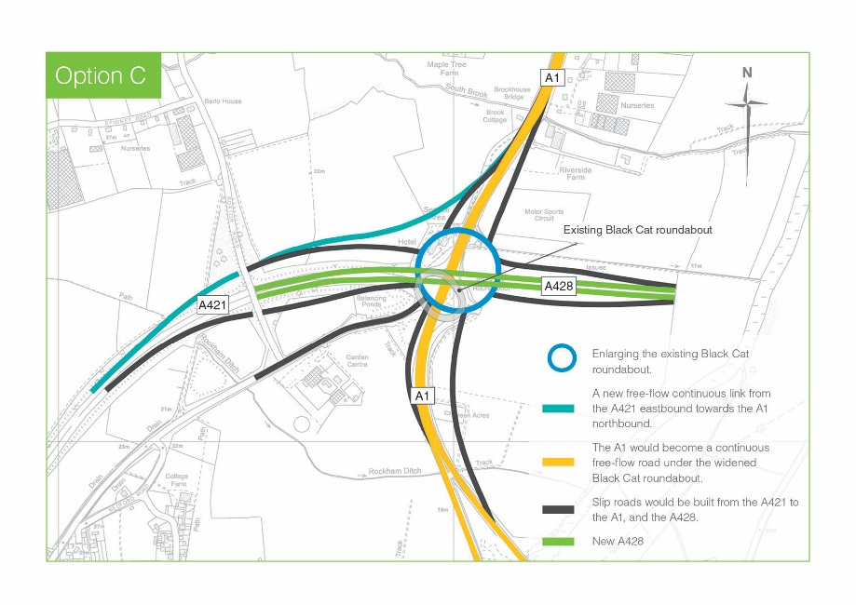
We are consulting on
Black Cat roundabout options

Slide 9
Black Cat roundabout – Option A
A1 Southbound to A421 Westbound - Drivers would exit the A1 southbound
carriageway and use a new free-flow link that bypasses any new roundabout junction.
A1 Southbound / Northbound to A428 Eastbound - Drivers would use a new slip road before travelling through 2 new roundabouts to join the new A428 eastbound.
A421 Eastbound to A1 Northbound - Drivers would use a new free-flow link that bypasses any new roundabout junction.
A1 Northbound to A421 Westbound - Drivers would use a new slip road before - travelling through 1 new roundabout to join a
new slip road onto the A421.
A421 Eastbound to A1 Southbound - Drivers would exit the A421 using a new slip road and travel through 2 new roundabouts to join onto the A1 southbound.

Slide 10
Black Cat roundabout – Option B
A1 Southbound to A421 Westbound - Drivers would exit the A1 southbound carriageway and use a new loop road that bypasses the existing Black Cat roundabout.
A1 Southbound / Northbound to A428 Eastbound – No change.
A1 Northbound to A421 Westbound - No change.
A421 Eastbound to A1 Northbound - Drivers would use a new free-flow link that bypasses the existing Black Cat roundabout..
A421 Eastbound to A1 Southbound – No change.

Slide 11
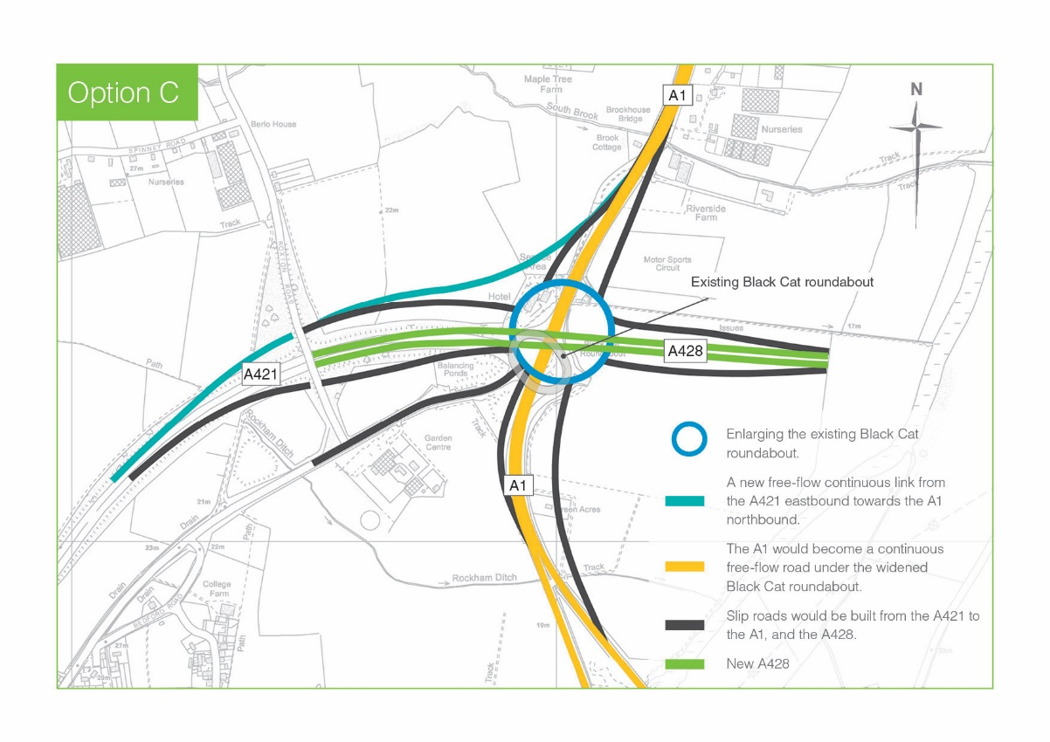
Black Cat roundabout – Option C
A1 Southbound to A421 Westbound - Drivers would exit the A1 southbound using a new slip road and travel through the improved Black Cat roundabout to join onto the A421.
A1 Southbound / Northbound to A428 Eastbound - Drivers would exit the A1 using a new slip road and travel through the improved Black Cat roundabout to join a new slip road onto the new A428.
A421 Eastbound to A1 Northbound - Drivers would use a new free-flow link that bypasses any new roundabout junction.
A421 Eastbound to A1 Southbound - Drivers would exit the A421 using a new slip road and travel through the improved Black Cat roundabout to
join onto the A1 southbound.
A1 Northbound to A421 Westbound - Drivers would exit the A1 northbound using a new slip road and travel through the improved Black Cat roundabout to join onto the A421.

Slide 12
We want feedback on:
Preferred route option(s)
Preferred Black Cat roundabout option(s)
Any other views / comments / concerns
Anyone can provide comments by:
Completing our online questionnaire
Downloading a copy of the questionnaire from our website
Picking up a brochure and completing the questionnaire attached
You can respond by:
Emailing us at: a428blackcattocaxtongibbet@highwaysengland.co.uk
Posting response to: Freepost A428 BLACK CAT TO CAXTON GIBBET
DEADLINE FOR ALL RESPONSES:
23 APRIL 2017 (11.59pm)

Slide 13
Consultation events
Public events
Location | Date | Time
Wyboston Lakes | Tuesday 21 March | 2-8pm
Cambourne Hub | Thursday 23 March | 2-8pm
Abbotsley Village Hall | Saturday 25 March | 10am-4pm
St Neots Priory Centre | Monday 27 March | 2-8pm
Tempsford Stuart Memorial Hall | Friday 31 March | 2-8pm
Eltisley Newton Primary School | Saturday 1 April | 10am-4pm
Landowner event (invite-only, drop-in session)
Location | Date | Time
Wyboston Lakes | Monday 20 March | 2-8pm

Slide 14
What happens after consultation?
Spring 2017 Response analysis
We will analyse and consider all consultation responses, alongside ongoing technical work
Summer 2017
Preferred Route Announcement
If there is a compelling case for the scheme and a suitable option is selected, a preferred route will be announced
Autumn 2017
Statutory public consultation
Following further on work on preferred route, we would consult on our proposals in line with DCO requirements
Following analysis of the statutory consultation responses, we will submit an application for Development Consent
Summer 2018
Submit DCO application
Winter 2019
DCO decision
Estimated date for Secretary of State decision on the scheme
March 2020
Estimated start of construction
Start of construction

Slide 15
Contacts:
Highways England:
a428blackcattocaxtongibbet@highwaysengland.co.uk
Andrew Kelly – Project Manager (Highways England)
Andrew.Kelly@highwaysengland.co.uk
Anne-Marie Rogers – Project Manager (Highways England)
Anne-marie.Rogers@highwaysengland.co.uk
Jacobs:
Olivia Fava-Verde – Stakeholder Lead (Jacobs)
olivia.fava-verde@jacobs.com

